Slide 1
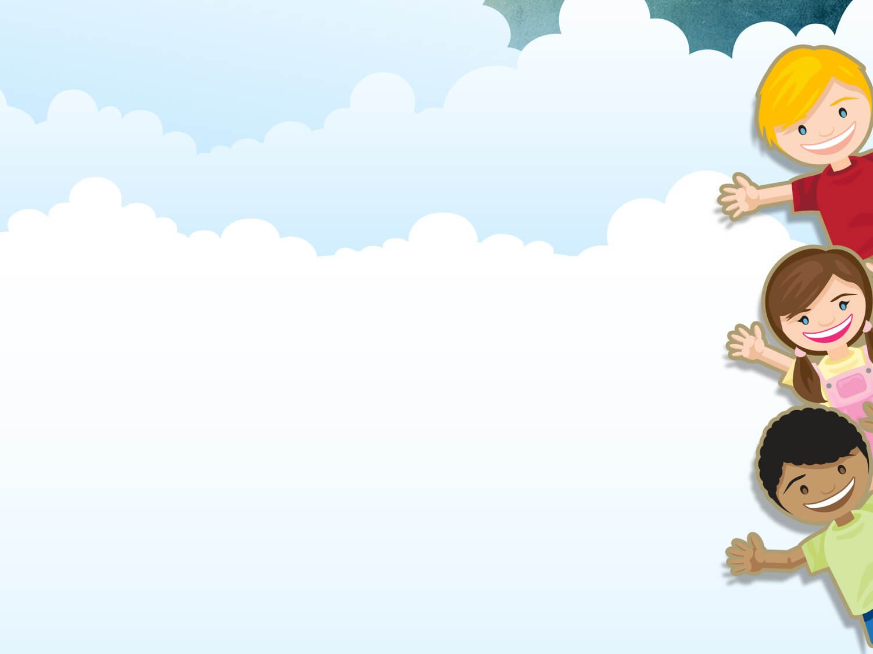
Welcome to our class

Slide 2
Listen to the song and answer the questions
How many planets are there in the solar system?
➔ There are 8 planets

Slide 3
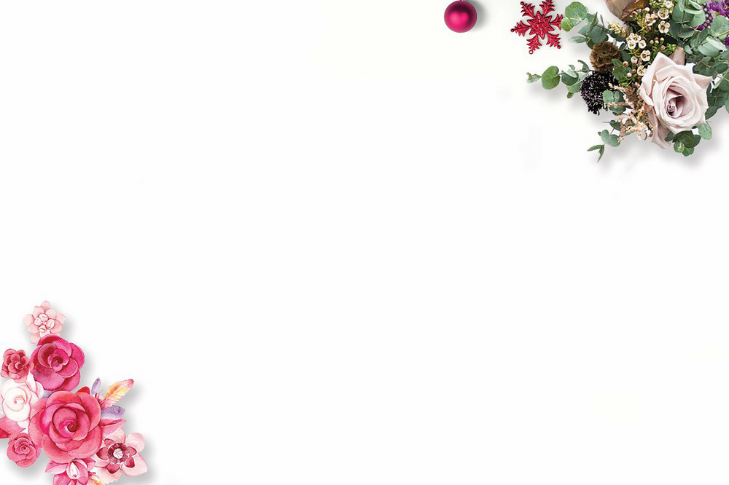
Unit 12: LIFE ON OTHER PLANETS
Period 98 – Lesson 2: A closer look 1

Slide 4
I. Vocabulary
- Mercury (n)
: Sao Thủy
- Venus (n)
: Sao Kim
- Saturn (n)
: Sao Thổ
- Mars (n)
: Sao Hỏa
- Neptune (n)
: Sao Hải Vương
- Jupiter (n)
: Sao Mộc
- Uranus (n)
: Sao Thiên Vương

Slide 5
II. PRACTICE

Slide 6
1/ : Use the name of the planets in the box to label the diagram of the solar system
Mercury
Venus
Saturn
Mars
Neptune
Jupiter
A
E
F
B
C
D

Slide 7
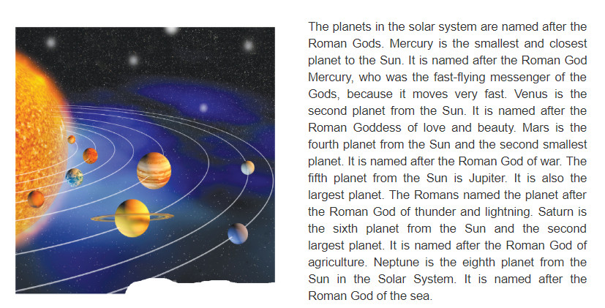
2/ Now scan the passage and check your answers

Slide 8
A
E
F
B
C
D

Slide 9
3/ Write the names of the planets that match the Roman God
The planets in the solar system are named after the Roman Gods. Mercury is the smallest and closest planet to the Sun. It is named after the Roman God Mercury, who was the fast-flying messenger of the Gods, because it moves very fast. Venus is the second planet from the Sun. It is named after the Roman Goddess of love and beauty. Mars if the fourth planet from the Sun and the second smallest planet. It is named after the Roman God of war. The fifth planet from the Sun is Jupiter. It is also the largest planet. The Romans named the planet after the Roman God of thunder and lightning. Saturn is the sixth planet from the Sung and the second largest planet. It is named after the Roman God of agriculture. Neptune is the eighth planet from the Sun in the Solar System. It is named after the Roman God of the sea.
Neptune
1. | God of sea
2. | God of agriculture
3. | God of war
4. | God of thunder and lightning
5. | God of love and beauty
Saturn
Mars
Jupiter
Venus

Slide 10
4/ Add suffixes –ful or –less to the words in the box. Note that some words can use either suffix
When we want to form an adjective, we can add suffixes –ful or – less to a noun or a verb
- ful means 'full of’ or 'having the quality of the noun’
Example: care → careful
help → helpful
- less often means ‘without’
Example: care → careless
home → homeless
1. Weight →
Weightless
2. Water →
Waterless
3. Beauty →
Beautiful
4. Wonder →
Wonderful
5. Resource →
Resourceless/ Resourceful
6. Air →
Airless

Slide 11
Ex 4b: Now use the topic of space to make a sentence for each new word. Compare your sentences with a partner.
Weightless
Waterless
Beautiful
Wonderful
Resourceless/ Resourceful
Airless
Example:
- Earth looks beautiful from space
- Venus is a dry and waterless planet.
- The Earth is a wonderful planet.

Slide 12
III. Pronunciation
Stress in words ending in –ful or - less
When we add –ful or –less to nouns or verbs to form adjectives, the stress of the words remain unchanged.
Example:
‘water → ‘waterless
‘hope → ‘hopeless/ ‘hopeful
for’get → for’getful

Slide 13
Ex 5: Put the stress in the corret place in the words. Then listen and check
thoughtless
meaningful
helpless
meaningless
helpful
thoughtful
useless
plentiful
useful

Slide 14
Ex 6: Read the following sentences and mark the stressed syllable on the words in italics. Then listen and repeat
1. Her speech on the environment was meaningful.
2. My teacher is so helpful when we don’t understand something.
3. I was helpless to stop the dog biting me.
4. This dictionary is so useful.
5. There is plentiful water for life on Earth.

Slide 15
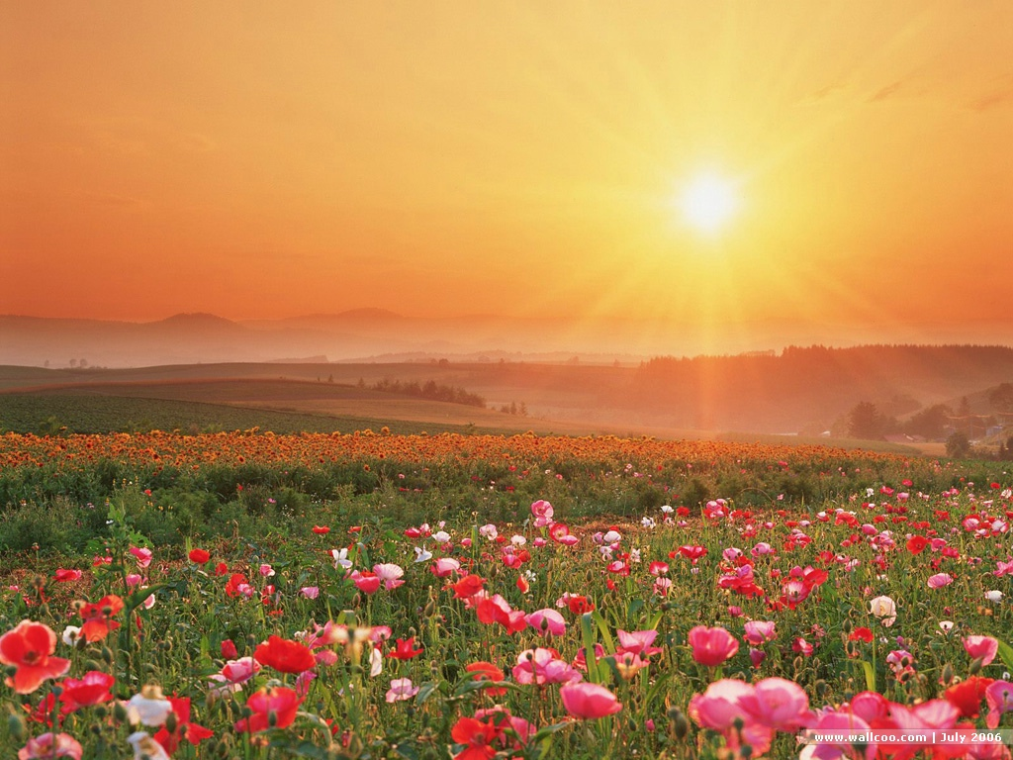
SEE U AGGAIN !
THANKS FOR WATCHING !

Slide 16
HOMEWORK
Learn by heart vocabulary.
Practise reading Ex 2
Prepare: Unit 12 - A closer look 2

